Slide 1
25
Discrete Mathematics
Set Identities

Slide 2













Slide 3









Slide 4









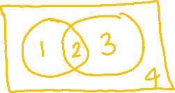

Slide 5
Up Next…
Proving Set Identities

